Slide 1
SHOE for Cross-Sections Measurements
From SHOE to MOCCASIN

Slide 2
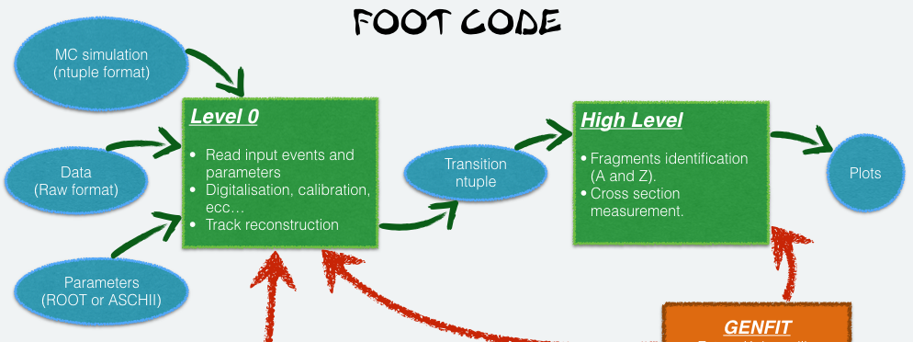
SHOE organization
DecodeRaw.cc
DecodeGlbAna.cc
DecodeGlb.cc

Slide 3
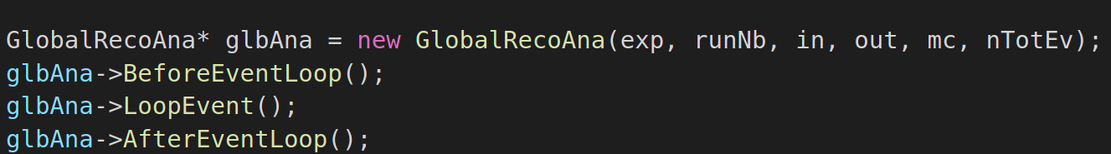
DecodeGlbAna
It initializes a pointer to the class GlobalRecoAna
For every event, loop methods are called.

Slide 4
glbAna->BeforeEventLoop()
Reading of the input parameters
Creation of the output file (trees and plots)
Setting of variables about beam and target

Slide 5
glbAna->AfterEventLoop();
Stamp luminosity (needed for cross-section measurements)
Writing on files plots of variables computed in glbAna→LoopEvent();
Closing files

Slide 6
glbAna->LoopEvent()
Loop on every event (1/2)
  Loop on every global track
    Study of purity of global track
    Study of MC values of tracks
      TWpoint vs global track studies
      Study of crossing regions
    Study of RECO values of tracks
    RECO/MC TRACKS cross section measaurements
  Loop on every MC particle
    MC cross section measaurements

Slide 7
glbAna->LoopEvent()
Loop on every event (2/2)
  Loop on every MC TW point
    Study of TW charge algorithm (for migration matrix plots)
  Loop on every VTX point for allignment studies
  Loop on every TW point for allignment studies

Slide 8
SHOE organization
MOCCASIN
Measurements Of Cross-sections Computed Analyzing SHOE Input Ntuples

